Slide 1
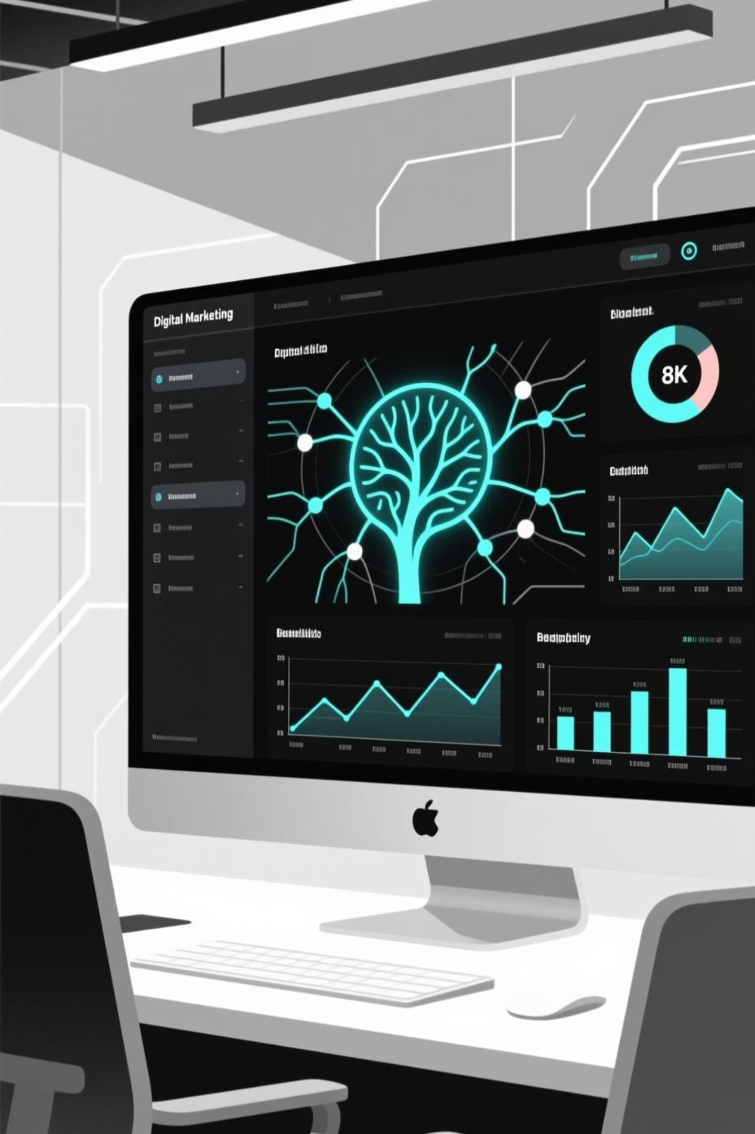
Digital Marketing Analysis Using Machine Learning

Slide 2
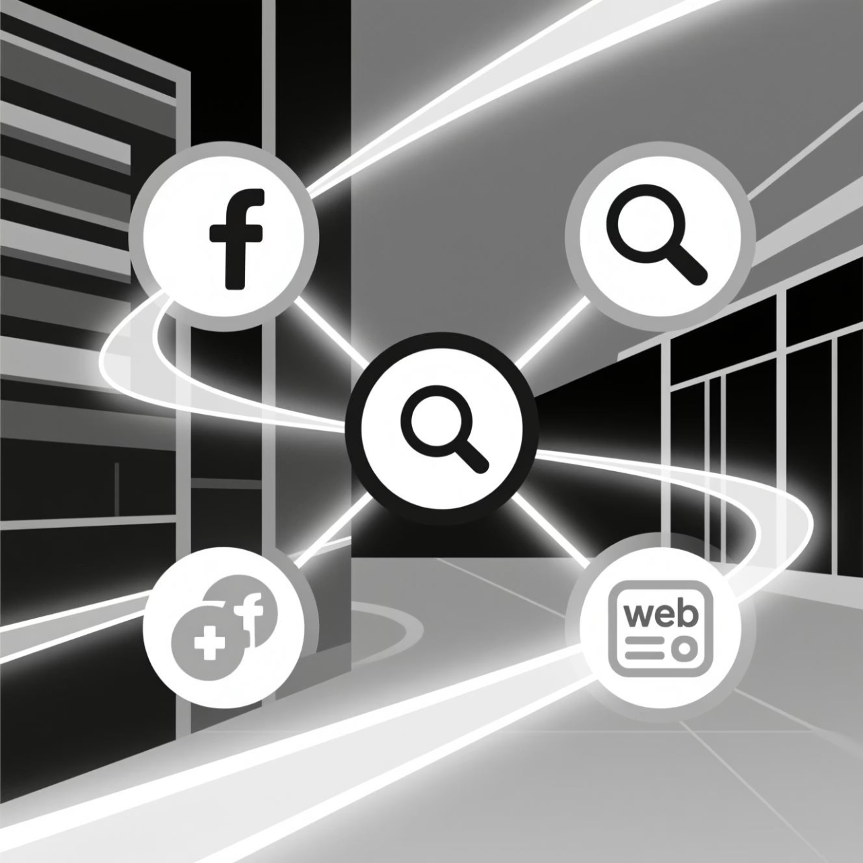
The Evolution of Digital Marketing
Modern digital marketing spans a vast ecosystem of interconnected platforms. From social media engagement to search engine visibility, the volume of data generated is unprecedented.
Omnichannel Presence: Integrating social, search, and web touchpoints.
Data Volume: Processing millions of signals in real-time.
ML Integration: Transitioning from reactive reporting to proactive, automated insights.

Slide 3


The Core Challenge: Data Without Direction
While businesses are swimming in data, they are often starving for actionable insights. Traditional analysis fails to keep pace with the velocity of digital interactions.
Missing link
Social engagement
Need for predictive modeling
Likes, shares, comments
Conversions Target
Ad performance
Website signals
Impressions and clicks
Visits, page depth, time
The primary hurdle is the inability to accurately predict customer conversions and determine which specific campaign variables drive long-term success.

Slide 4




Exploratory Data Analysis (EDA)
Before modeling, we must understand the landscape of our data. EDA allows us to identify the hidden structures within our customer base.
Demographics
Channel Performance
Analyzing age, location, and device preferences to segment the audience effectively.
Evaluating which platforms (Organic vs. Paid) yield the highest engagement rates.
Conversion Funnel
Trend Discovery
Deep dive into Click-Through Rates (CTR) and the friction points in the user journey.
Identifying seasonal peaks and behavioral shifts over time.

Slide 5
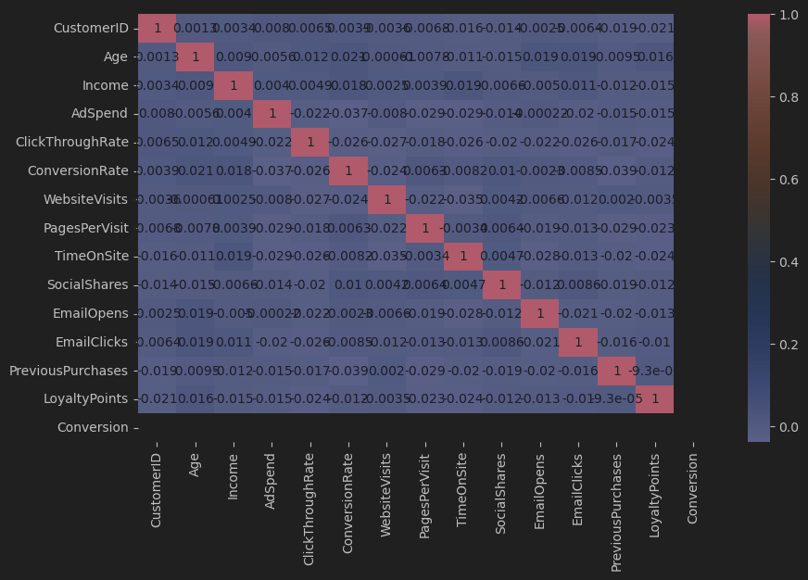

Slide 6
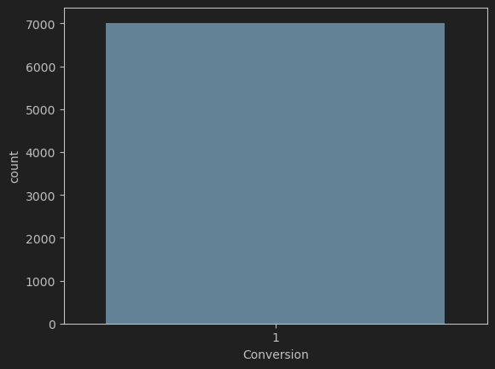

Slide 7
Advanced Machine Learning Models
We employ three distinct modeling approaches to ensure robust prediction and interpretability.
Decision Trees
Random Forest
Naive Bayes
Provides a clear, interpretable roadmap of how customer decisions are made, ideal for rule-based classification.
An ensemble method that significantly improves accuracy by combining multiple decision trees to reduce variance.
A high-speed probabilistic classifier that excels in sentiment analysis and real-time prediction tasks.

Slide 8

Strategic Outcomes & Conclusion
The Data-Driven Advantage
Machine learning transforms marketing from a "best-guess" discipline into a precision science.
Precision Targeting: Minimize ad spend waste.
Predictive Response: Anticipate customer needs before they arise.
Agile Decisions: Pivot strategies based on real-time data flow.
Targeting Accuracy
Response Prediction
Cost Reduction

Slide 9

Thank You

Slide 10




Contact & Resources
Connect with our data science team for further exploration of these marketing models.
Email Us
LinkedIn
analytics-team@marketing-ml.com
linkedin.com/company/digital-ml-pros
Whitepapers
Download our latest case studies at marketing-ml.com/resources

